Slide 1

Hotel Management system with billing
20104085 Gulshan Yadav
20104093 Rahul Yadav
20104115 Mansi Viramgama
20104119 Mayank Viramgama
Project Guide
Prof. Neha Deshmukh
Notes:
1

Slide 2
Contents
Introduction
Objectives
Scope
Features / Functionality
Project Outcomes
Technology Stack
Designs
Notes:
2

Slide 3
1. Introduction
Problem Identified :
We need to build a hotel management system with billing
Solution Proposed :
We have provided a java application built on maven, that will manage all the bookings in hotel.
Notes:
3

Slide 4
3. Scope
Can be applied in tourism industry
Can be used by the hotels to manage the billing process.
Notes:
4

Slide 5
2. Objective
To create an environment where a hotel can list it’s rooms on their platform.
A hotel admin can Add/remove it’s employees and can also add or subtract the rooms.
Notes:
5

Slide 6
4. Feature /Functionality
Admin and employee can login and can handle bookings
An employee can book a room for customer, and can also handle the billing at checkout.
Admin can add or remove the employees and can also handle the basic tasks of employee.
Notes:
6

Slide 7
5. Outcome of Project
Admin and employee can login, and admin can create new entries for new employee.
Receptionist can search through the logs for older bookings
receptionist can get an info about the current status of bookings
Both receptionist and admin can handle booking.
An invoice will be generated once receptionist confirms the payment.
Hotel owner can list the sweets.
Notes:
7

Slide 8


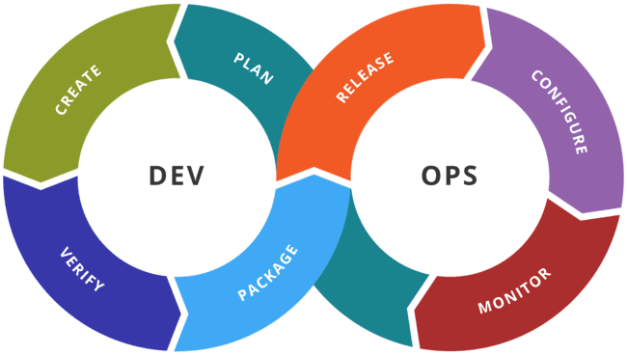

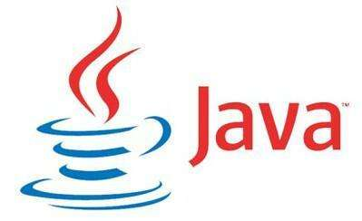

6. Technology Stack
Maven Application built on JAVA and JavaX SWING
MySQL as backend
PhpMyAdmin as the software for analyzing the db.
Github for storing and syncing the code between devs.
Docker for wrapping the code in a stable env.
Continuous integration for testing the code for any issues.
Notes:
8

Slide 9
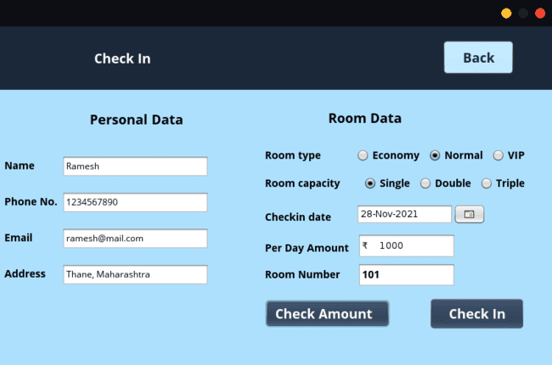
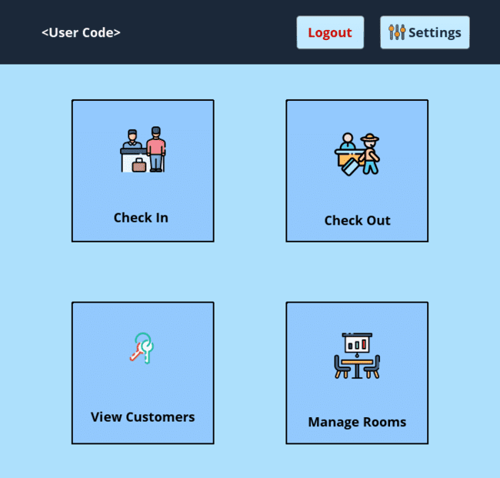
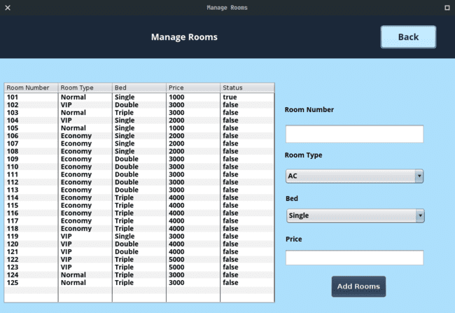
7 Software design
Notes:
9

Slide 10
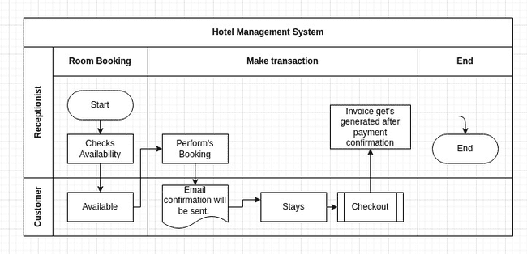
8 BLOCK DIAGRAM

Slide 11
Thank You...!!
Notes:
11

